Slide 1
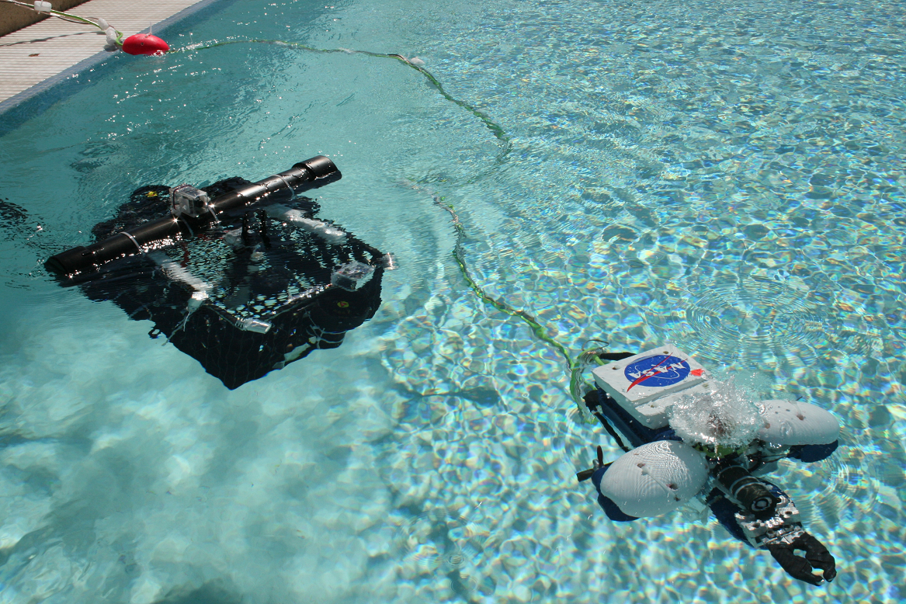
The Space Grant Robotics Team Michael Veto Advisor: Dr. Phil Christensen
NASA Space Grant Symposium
April 17, 2010

Slide 2
Objectives
Promote hands-on engineering
Practice systems engineering
Learn new skills
Foster a cooperative work environment for students
Promote science and technology to community

Slide 3
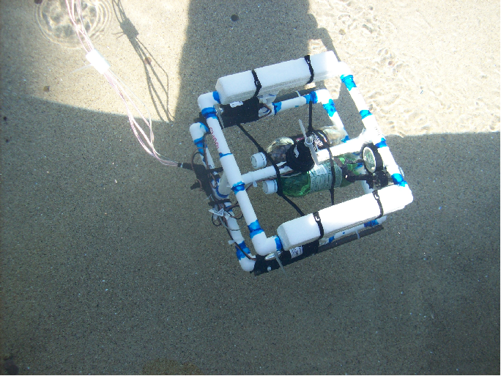
Hands-on design of ROV (Remotely Operated Vehicle)

Slide 4
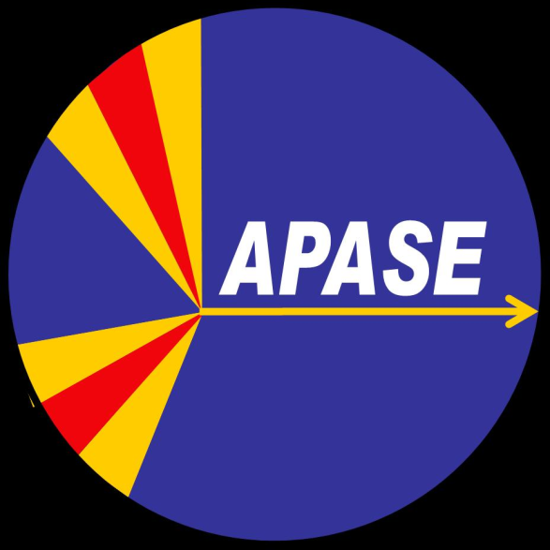
Competitions
National Underwater
Robotics Competition
(Chandler, AZ)
Marine Advanced Technology Education Competition (Buzzards Bay, MA)

Slide 5
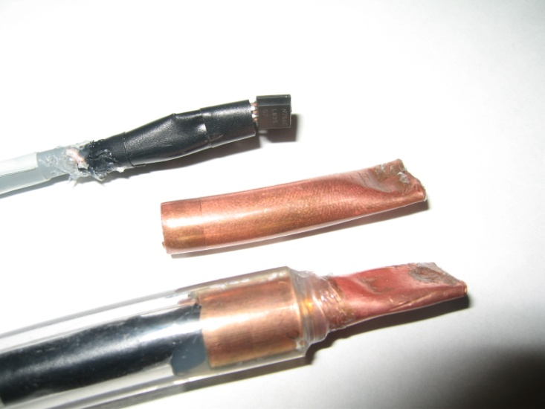
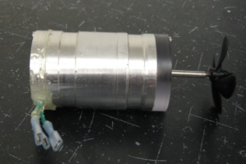
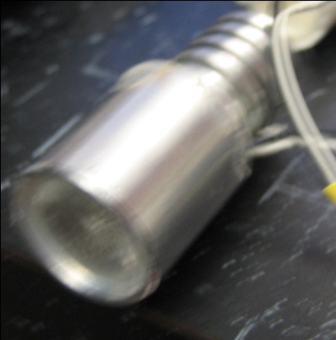
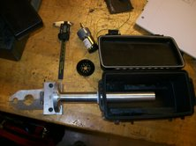
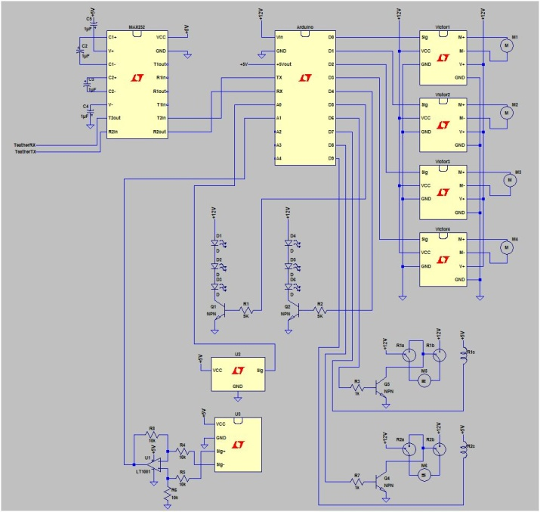
Systems Engineering
Lights
Propulsion
Sensors
Robotic Arm
Electrical Schematic

Slide 6
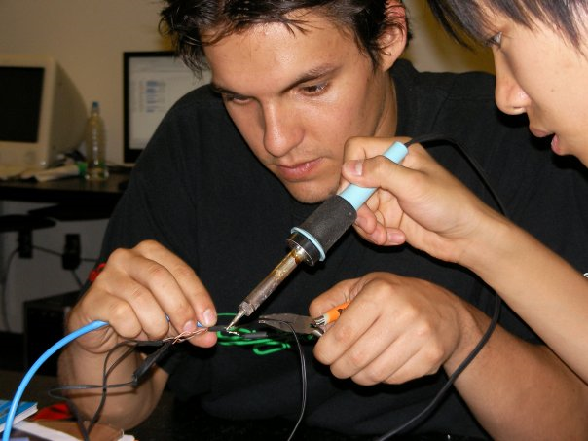
Learning New Skills

Slide 7
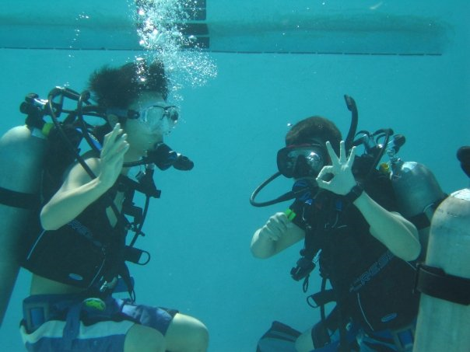

Slide 8
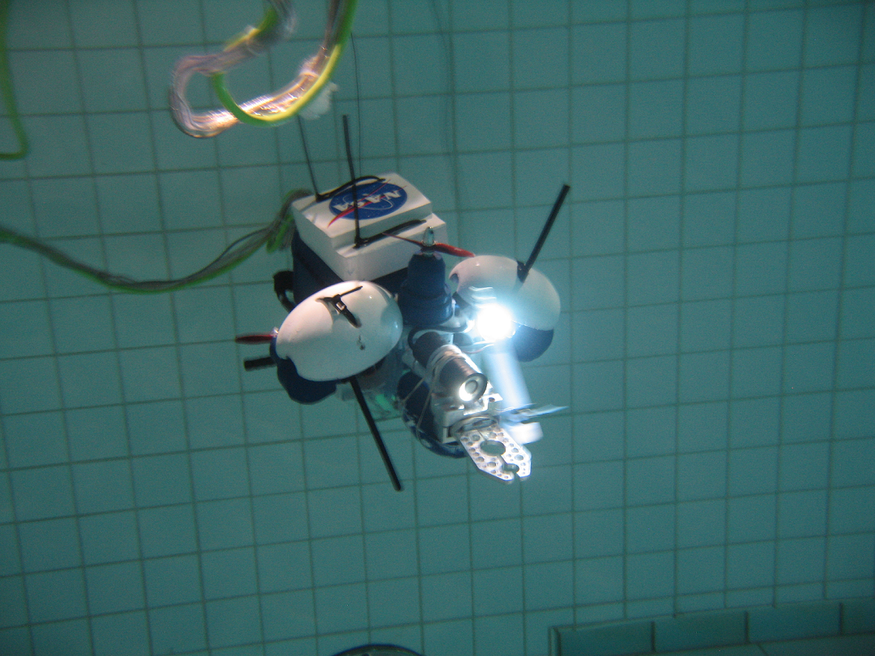
Aquabot

Slide 9
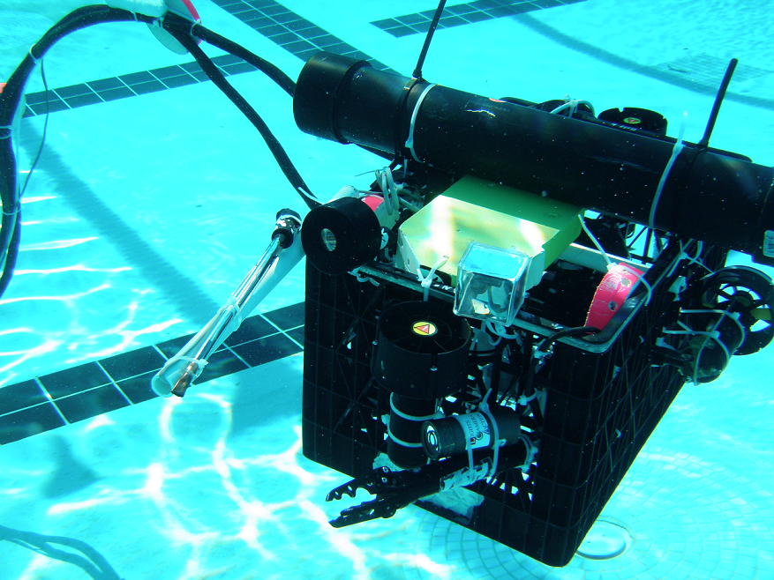
RIAB

Slide 10
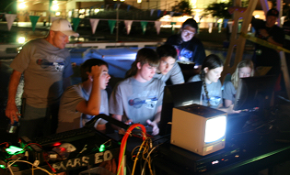
Team Competition

Slide 11
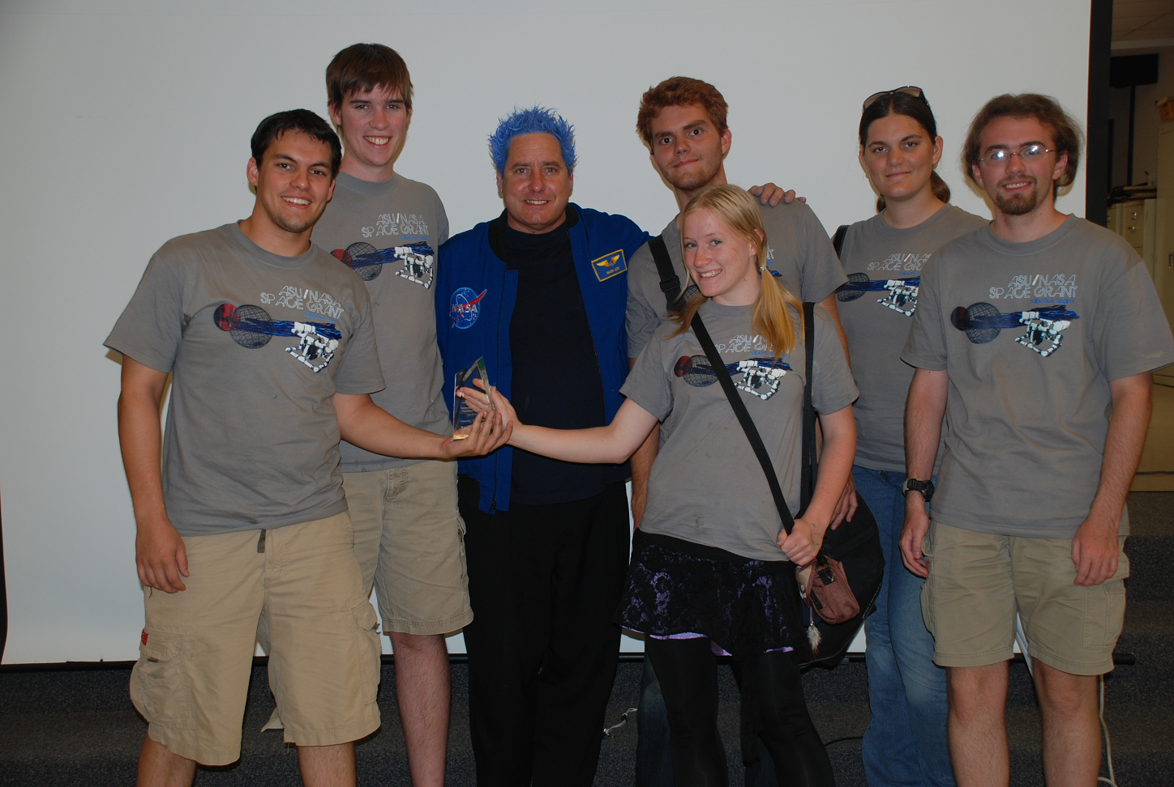

Slide 12
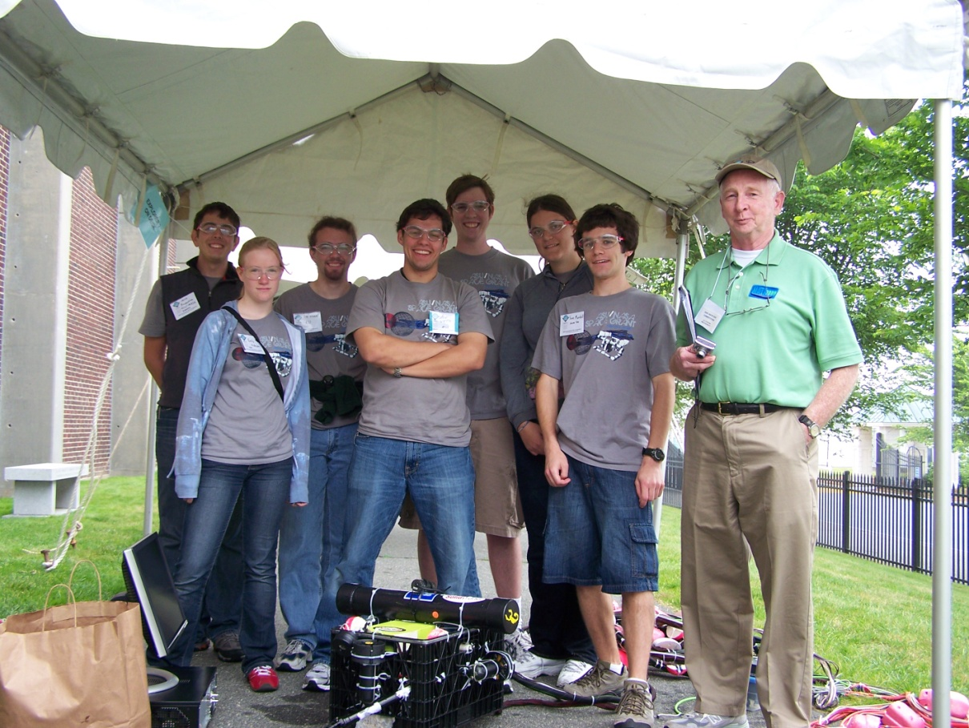

Slide 13
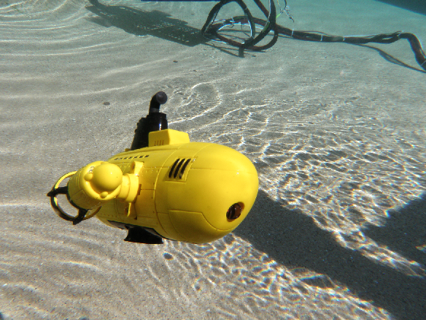
“Aloha” Team Spirit Award

Slide 14
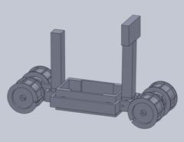
Upcoming Season
Underwater
NURC - Chandler
MATE – Hawai’i
Earth and Sky
Robot on a Rocket
(ROAR)

Slide 15
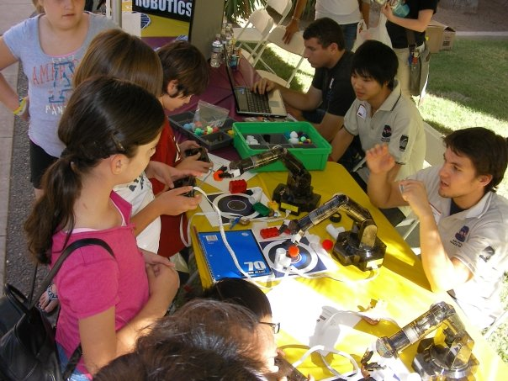
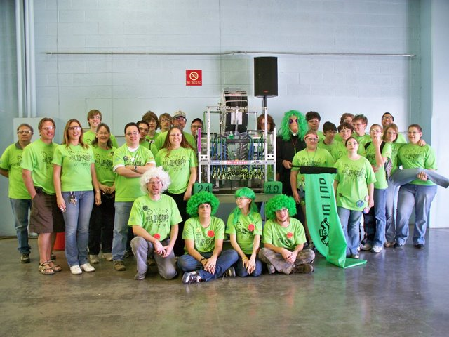
Outreach
Work with students at on-campus events
Mentor FIRST High School robotics teams
Marcos de Niza
Hamilton
Corona del Sol
Seton

Slide 16
Acknowledgements
Mentor
Dr. Phil Christensen
Special Thanks
Shea Ferring
Mark White
Dr. Tom Sharp
Space Grant Office
Candace Jackson
Danielle Pies

